Slide 1


Operating Systems
Introducing UniShell - A Custom Linux Shell for Enhanced Student Productivity
Hamza Zarah & Albert Jasari
Universität Basel, 14. April 2023
Universität Basel, 14. April 2023

Slide 2

Why UniShell?
Need for productivity tools for students
Enhance time management and focus
Intergrated environment for better workflow

Slide 3
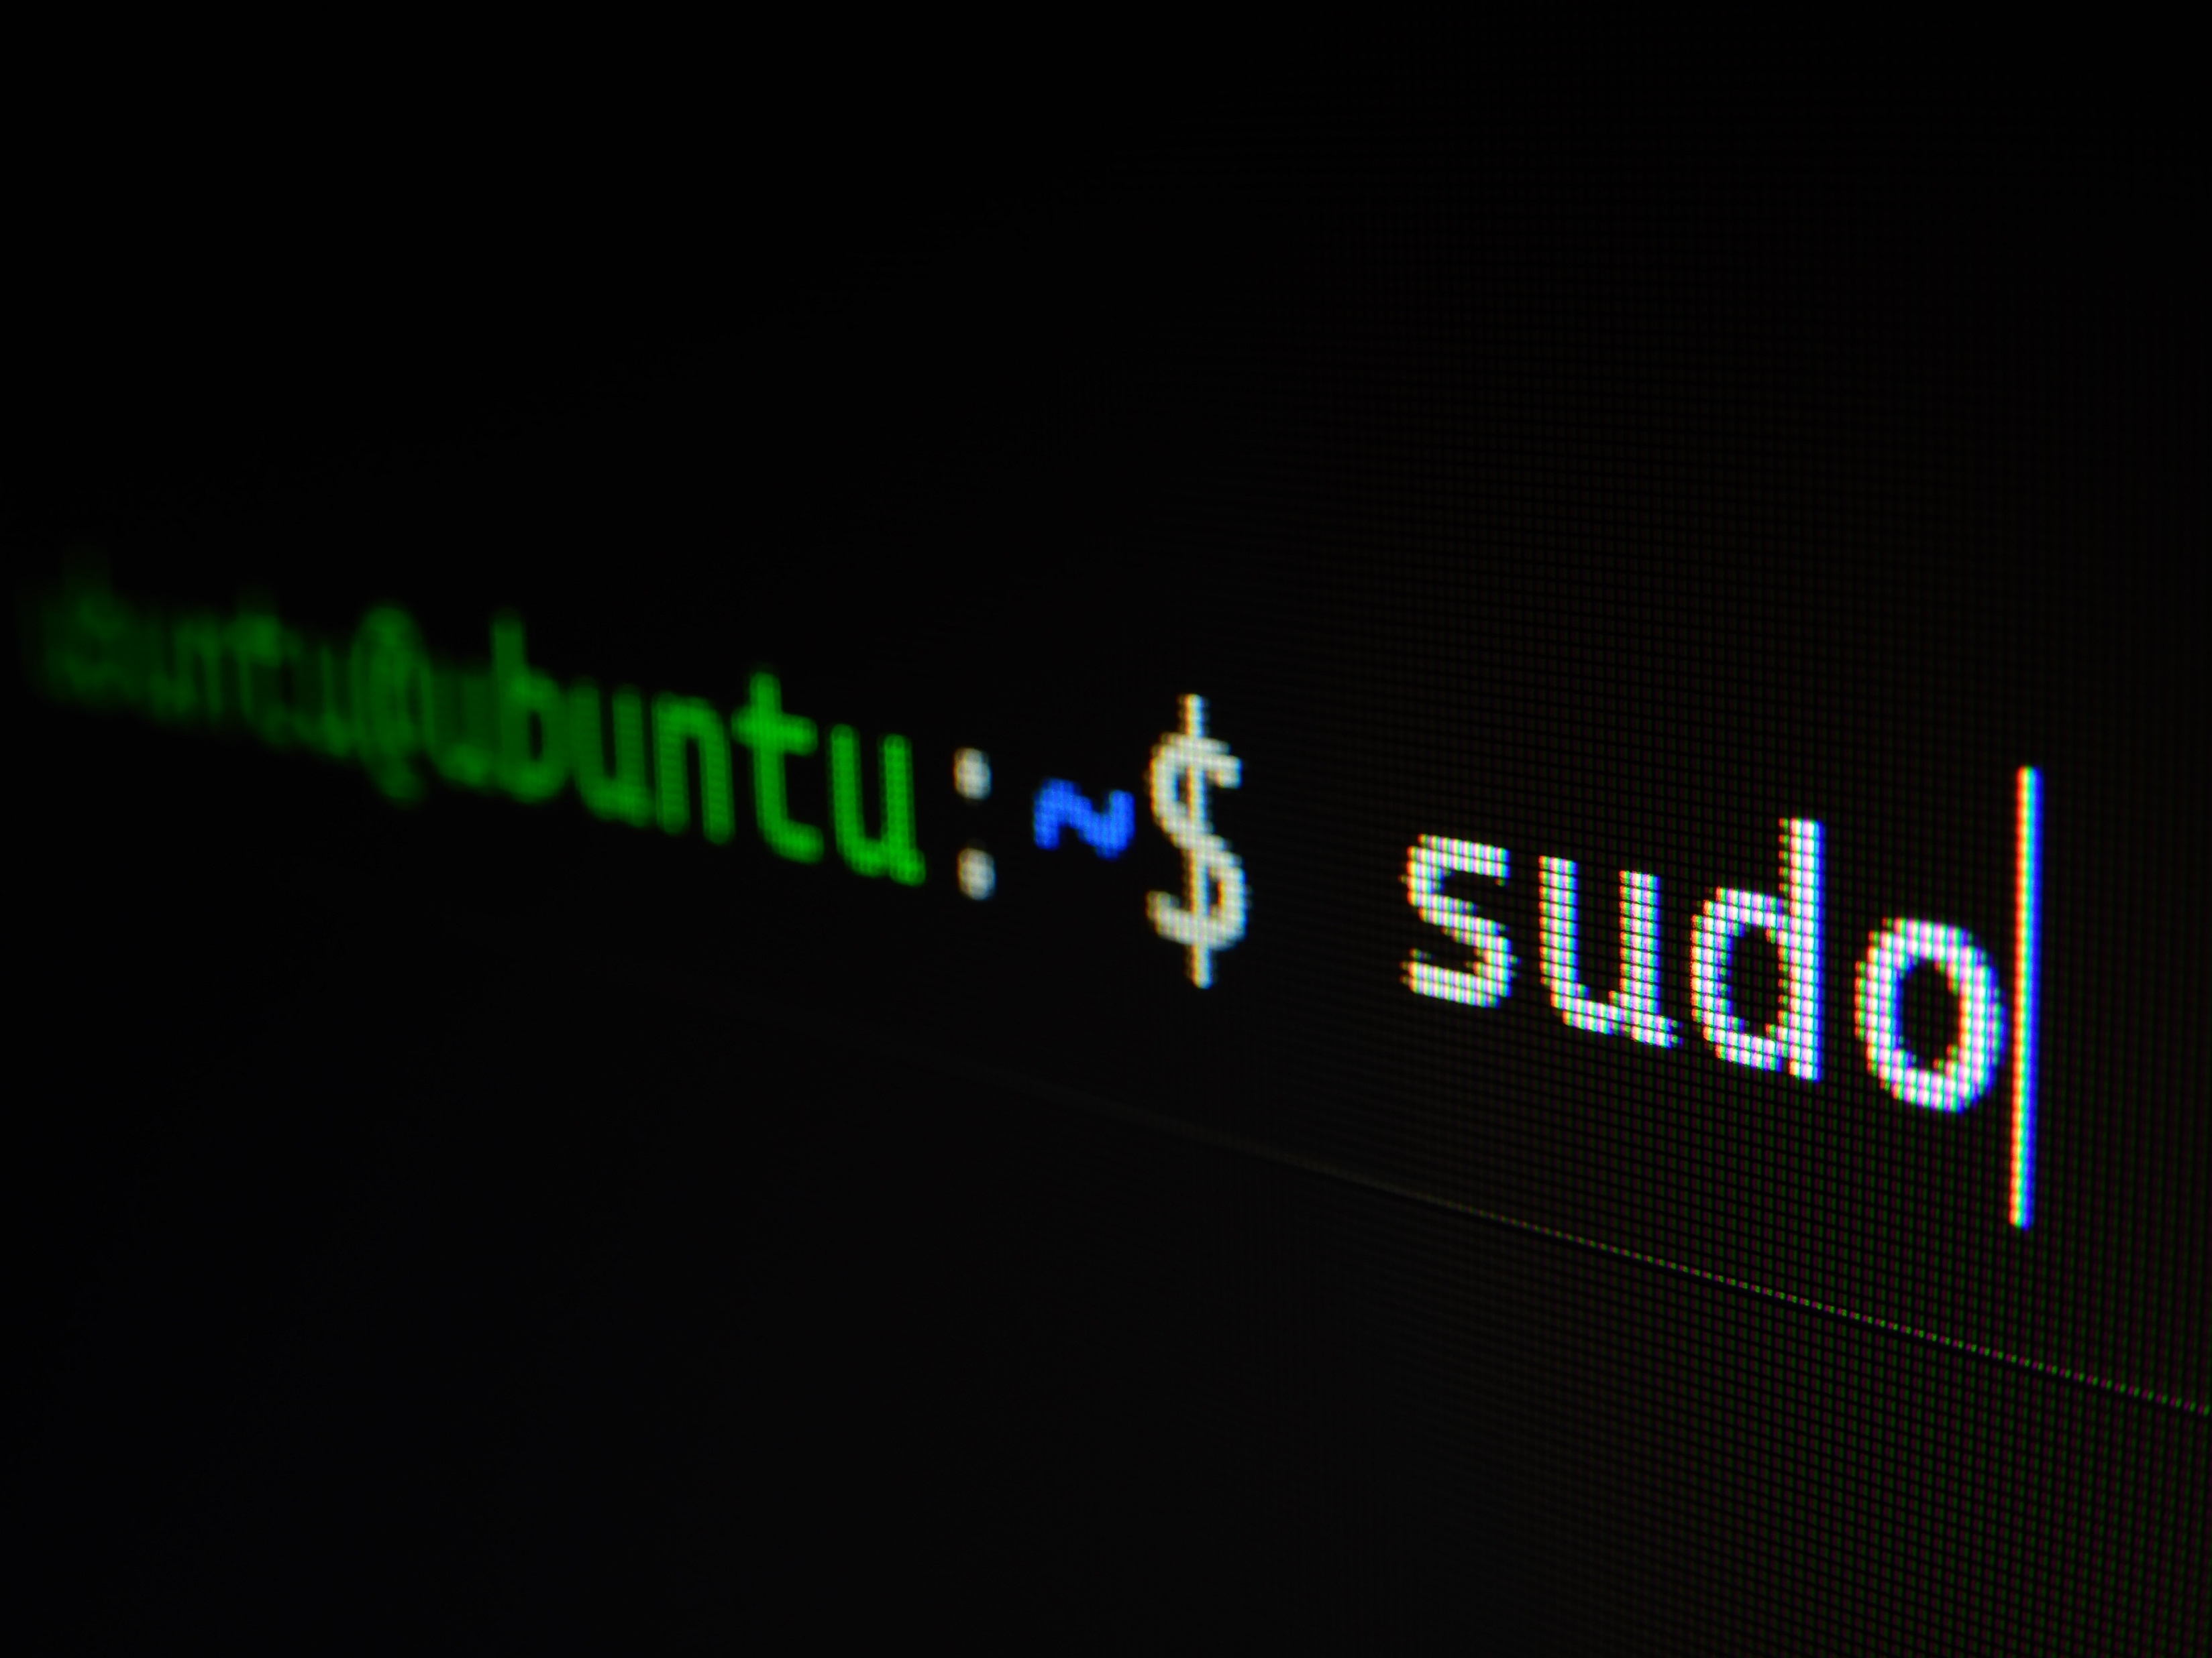
Linux Shell - An Overview
Text interface for computer interaction
Kown as shell, command line, terminal, console
Executes programs and system commands

Slide 4

Introducing UniShell
Custom Linux Shell for students
Goal: Improve productivity
Developed using C programming language

Slide 5
UniShell Architecture
Interface (Command line I/O)
Core functionality (Built-in commands)
External modules (Pomodoro, reminders)
Interface
Core Functions
Linux Kernel
External Modules
User Commands

Slide 6



Key Functionalities
Change current directory (cd)
Helper function (help)
Exit shell (exit)
Welcome message at startup
Start learning journey (learn)
Pomodoro timer (pomodoro)
Interface switching (switch-interface)
Water drinking reminder (water-reminder)
Movement reminder (movement-reminder)

Slide 7
Development Timeline
Milestone 1: Core functionality
Milestone 2: External modules
Milestone 3: Testing and debugging
Milestone 4: Finalizing and deployment

Slide 8
In Conclusion
Custom Linux Shell for students
Potential impact on productivity
Exciting future development opportunities

Slide 9
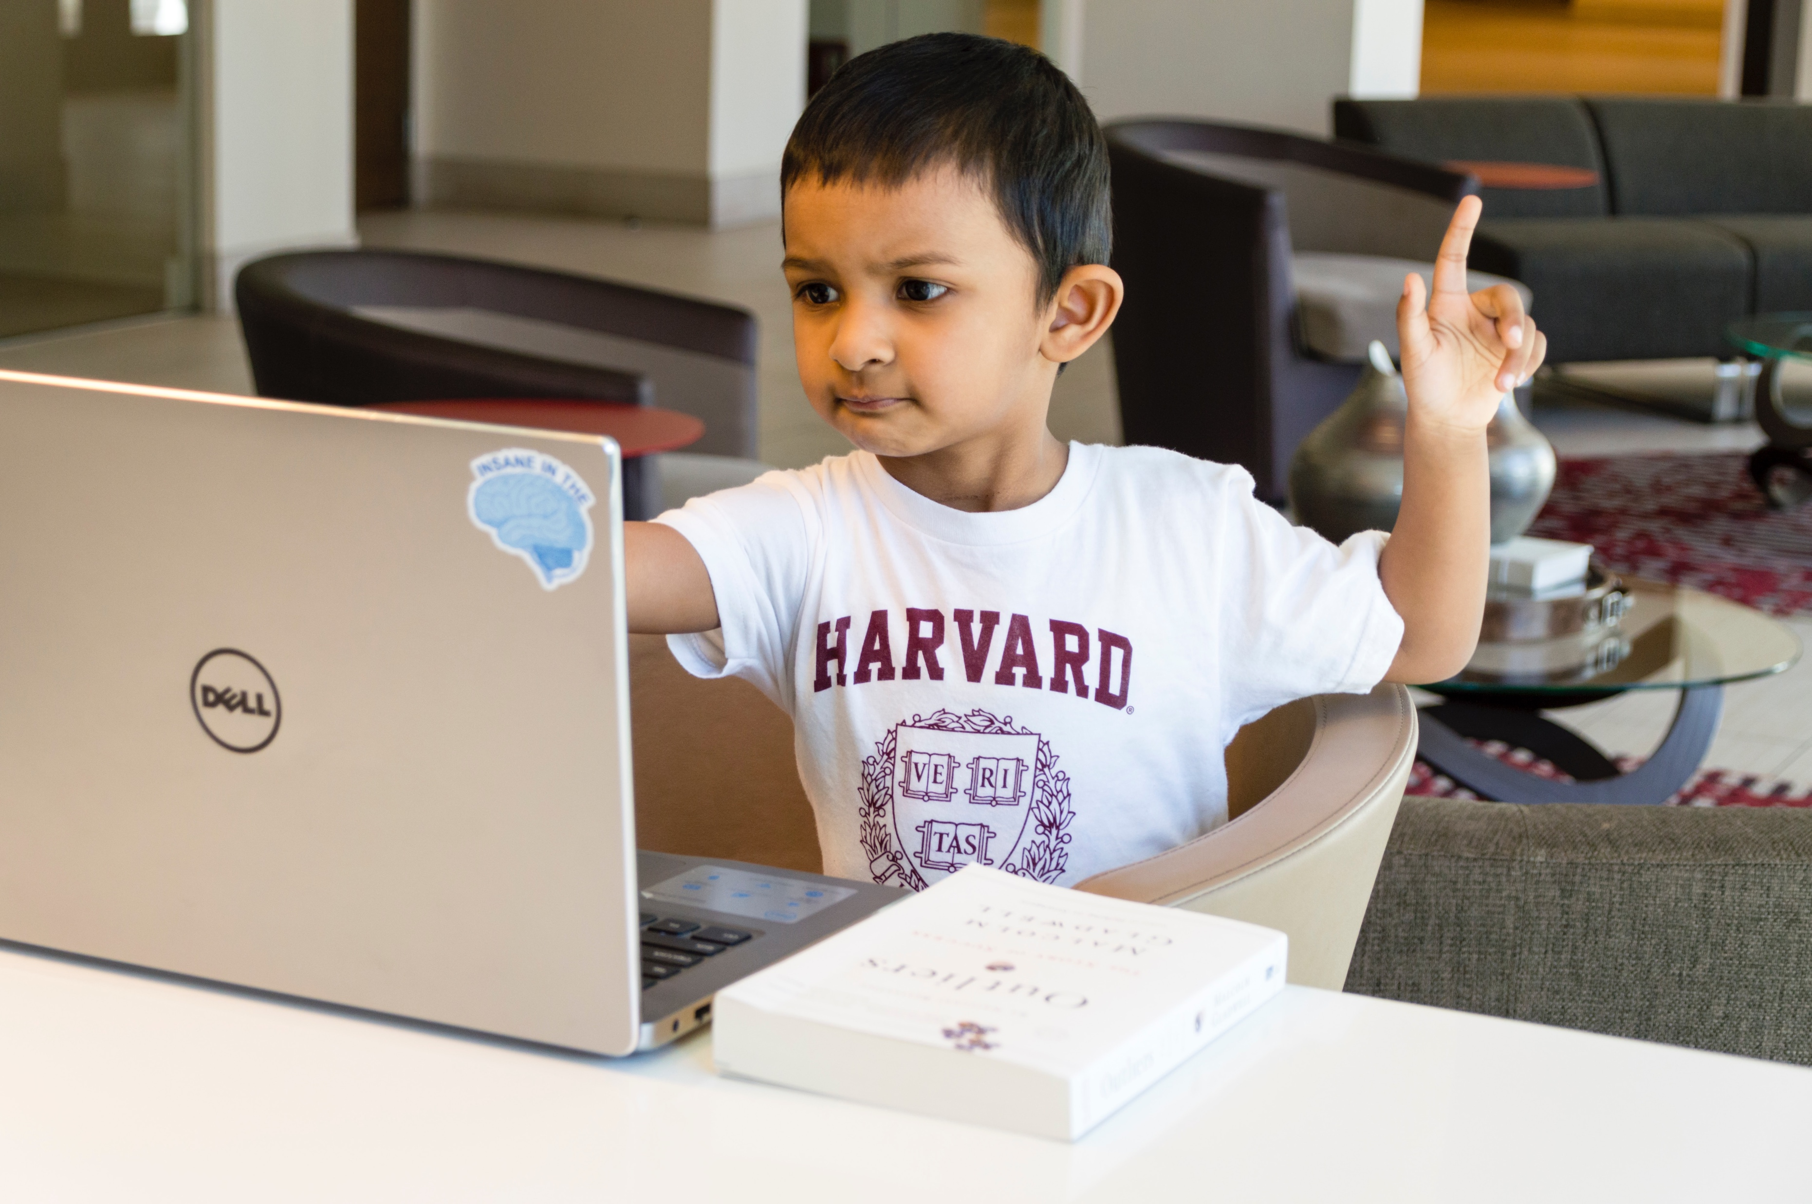

A rational design process – and how to fake it
Questions & Answers
We welcome any questions you may have about UniShell.

